Slide 1
AGILE METHODOLOGY

Slide 2
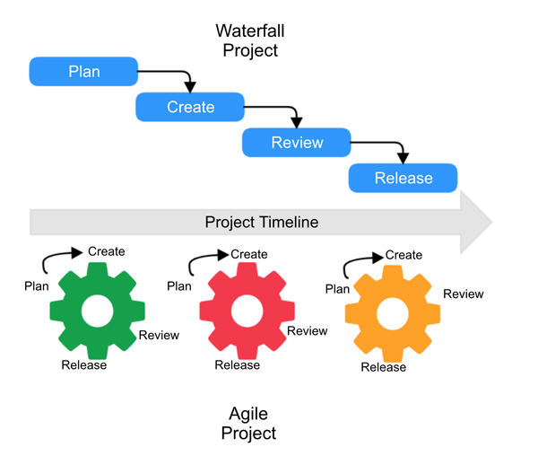
Agile is an iterative solution methodology where we deliver a basic solution for a problem or product and then enhance it over the time.
Why Agile is better than Traditional solutions?
Testing of product can be done from the beginning (regularly) and not at the end.
More flexibility to customers by building small products over the time.
Customer’s direct input in the product.
Not just an IT developer or product manager thing, can be used in various industries (commercial projects, operations projects etc.)

Slide 3
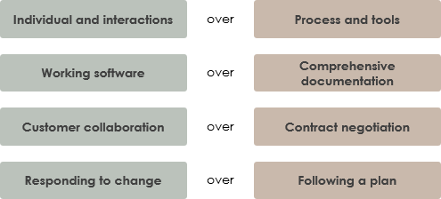
AGILE MANIFESTO
Written in February, 2001, in Park City, Utah, by seventeen leading software developers

Slide 4
EXTREME PROGRAMMING – AN AGILE BASED FRAMEWORK
Extreme Programming (XP) is an agile software development framework that aims to produce higher quality software, and higher quality of life for the development team.
When Applicable?
Dynamically changing software requirements.
Small, co-located extended development team.
The technology you are using allows for automated unit and functional tests.
Pair Programming plays an important role in XP. It means all production software is developed by two people sitting at the same machine. You effectively get a continuous code review and quicker response to nagging problems that may stop one person dead in their tracks.
Unit test is used at every step to make the program or code efficient.

Slide 5
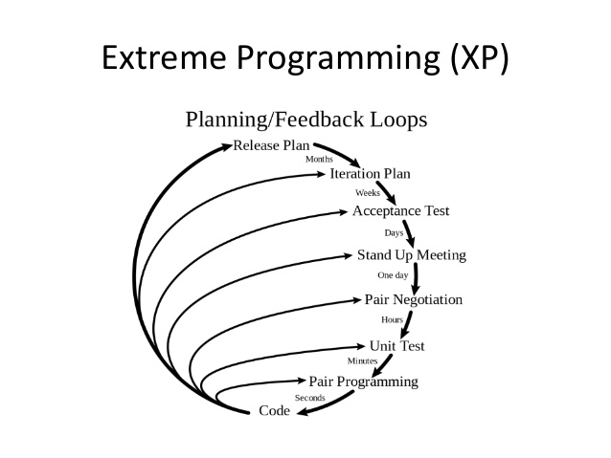

Slide 6
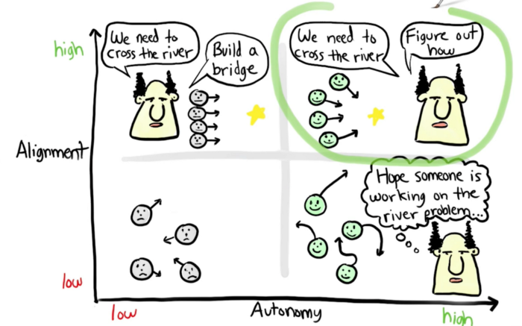
REAL LIFE EXAMPLE OF AGILE - SPOTIFY
Spotify is recognized for its agile processes: the company’s smallest group unit, called squads, behave as autonomous startups.
Each squad focuses on a specific function and iterates based on the minimum viable product, releasing updates early and often.
At Spotify, each squad handles a small project; however, each projects builds to a common goal of a creating greater customer value.
They have very little standardization and squads have a lot of autonomy.

